Slide 1
BCT 2305: Data Communications
Lecture 2a : Data Transmission

Slide 2
Outline
Data Transmission-Physical Layer and Media - data, signals and signal characteristics, frequency and time domains, analog and digital transmission – base band, broad band – impairments – attenuation, distortion, noise – analog to digital – PCM– Transmission modes – parallel, serial , asynchronous, synchronous – digital to analog – ASK, FSK, PSK – analog to analog – AM, FM, PM – Chanel, capacity, Multiplexing – FDM, WDM, TDM. Transmission Media . Guided Media – twisted pair, co-axial, fiber optic – unguided – wireless communication, switching techniques

Slide 3
What is data communication?
Not to be confused with telecommunication which is—
Any process that permits the passage from a sender to one or more receivers of information of any nature, delivered in any easy to use form by any electromagnetic system.
Data communication-
Defined as a subset of telecommunication involving the transmission of data to and from computers and components of computer systems.
More specifically data communication is transmitted via mediums such as wires, coaxial cables, fiber optics, or radiated electromagnetic waves such as broadcast radio, infrared light, microwaves, and satellites.

Slide 4
Data Communications contd
The term telecommunication means communication at a distance. The word data refers to information presented in whatever form, as agreed upon by the parties creating and using the data.
Data communications are the exchange of data between two devices via some form of transmission medium such as a wire cable.

Slide 5
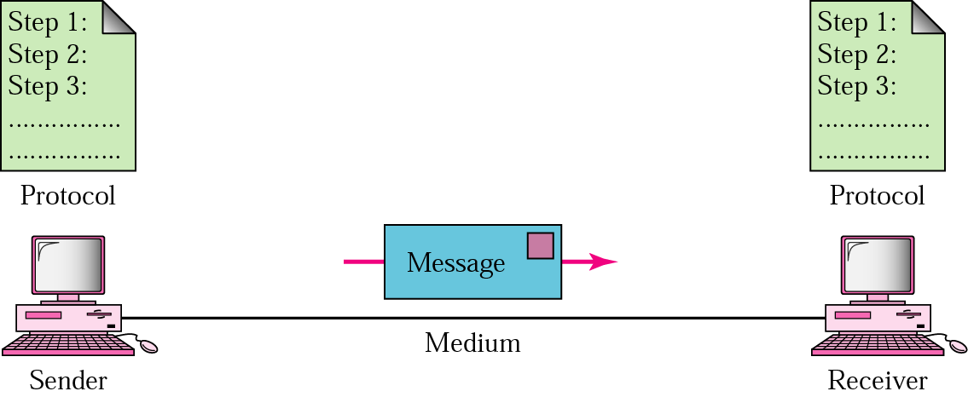
Five Components of Data Communication
Message
Sender
Receiver
Medium
Protocol

Slide 6
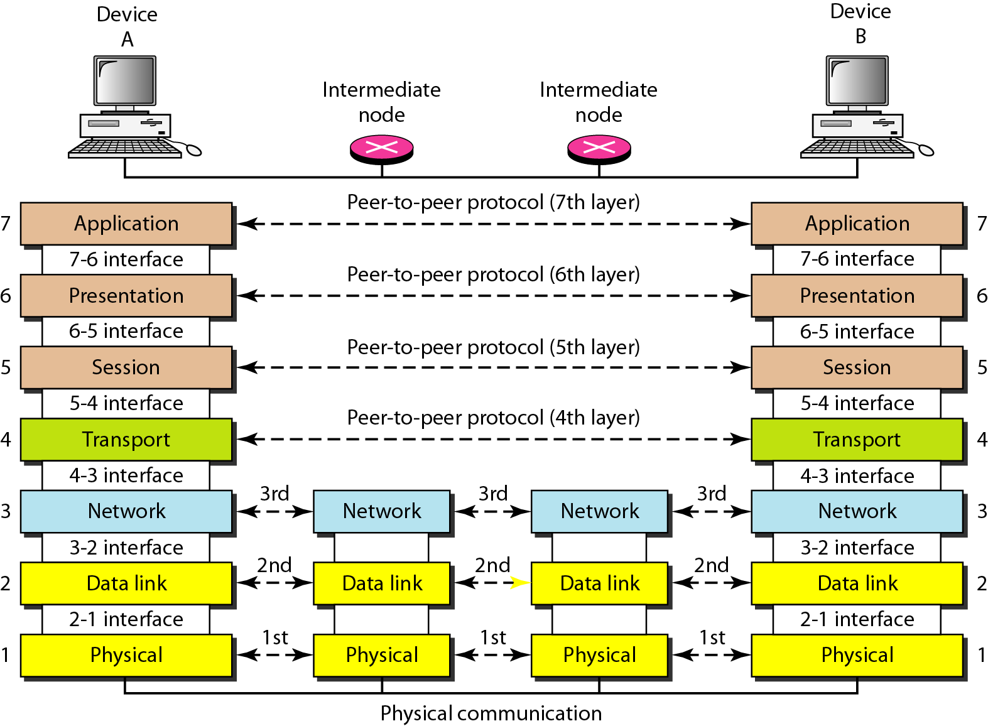
Transmission

Slide 7
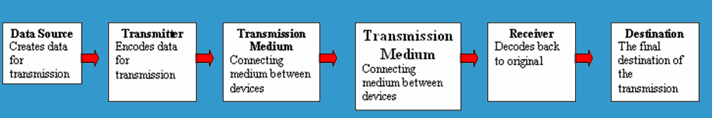
5 Basic Components
Every communication system has 5 basic requirements
Data Source (where the data originates)
Transmitter (device used to transmit data)
Transmission Medium (cables or non cable)
Receiver (device used to receive data)
Destination (where the data will be placed)

Slide 8
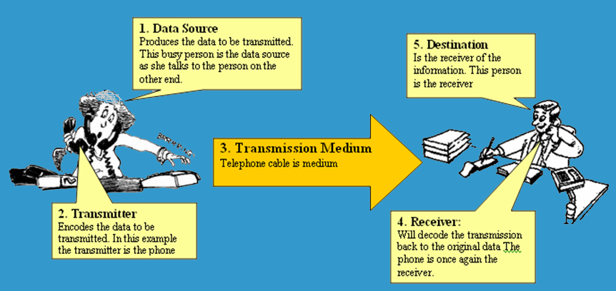
5 Basic Components

Slide 9
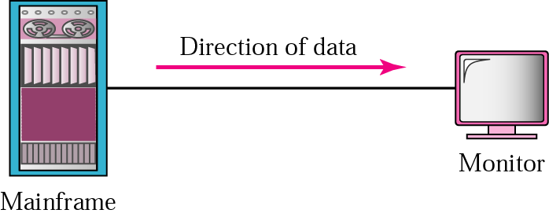


Transmission Direction
Simplex
Half Duplex
Full Duplex

Slide 10
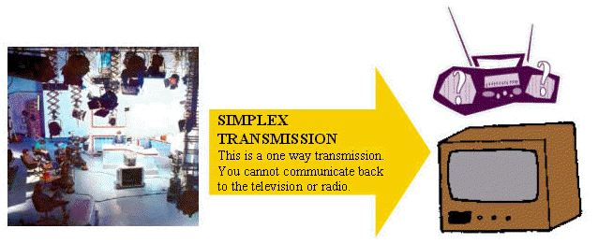
Transmission Direction
- simplex: One direction only

Slide 11
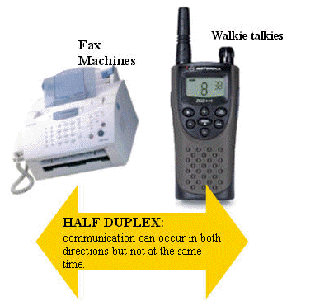
Half Duplex Transmission
half duplex: Both directions but only one direction at a time

Slide 12
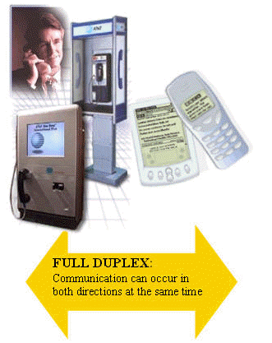
Full Duplex Transmission
full duplex: send and receive both directions at once

Slide 13
Signal Transmission
Any information carrying transmission may be:
analog or digital
Serial or parallel

Slide 14
Serial Transmission
Data is transmitted, on a single channel, one bit at a time one after another
- Much faster than parallel because of way bits processed (e.g. USB and SATA drives)
Sender transmitted
Receiver received
1
0
0
1
1
0
0
1

Slide 15
Parallel Transmission
each bit has it’s own piece of wire along which it travels
- often used to send data to a printer
1
0
0
1
Receiver received
Sender transmitted
1
0
0
1
All bits are sent simultaneously

Slide 16
Digital Data Transmission
Each single bit can be represented by a signal element.
Each signal element takes some time to send.
Bit rate: the number of bits that can be sent out per unit of time.
1
1
0
0
1
1
1
0
0
time

Slide 17
The objective of data transmission ?
Maximize the data rate: number of bits that the system can transmit in a unit of time
within an acceptable bit error rate
Why there could be bit errors?
The signal received by the receiver is different from the signal sent from the sender
Usually, if data rate becomes higher, it is more difficult for the receiver to recognize the signal
higher data rate results in higher bit error rate
In order to achieve high data rate with low bit error rate, we need to study the principle of data communications. The ideal balance.

Slide 18
The Relationship Between Frequency and Bits Per Second
Higher Data Transfer Rates
How do you send data faster?
Use a higher frequency signal (make sure the medium can handle the higher frequency
Use a higher number of signal levels
In both cases, noise can be a problem

Slide 19
Data and Signals
Data are entities that convey meaning (computer files, music on CD, results from a system)
Signals are the electric or electromagnetic encoding of data (telephone conversation, web page download)
Computer networks and data/voice communication systems transmit signals
Data and signals can be analog or digital

Slide 20
Analog vs. Digital
Analog is a continuous waveform, with examples such as (naturally occurring) music and voice
It is harder to separate noise from an analog signal than it is to separate noise from a digital signal (imagine the following waveform is a symphony with noise embedded)

Slide 21
Why Study Analog?
Telephone system is primarily analog rather than digital (designed to carry voice signals)
Low-cost, ubiquitous transmission medium
If we can convert digital information (1s and 0s) to analog form (audible tone), it can be transmitted inexpensively
Media are inherently analog too, real world is analog

Slide 22
Which Signal/Data is Better Analog or Digital?
Digital is better
Even Analog data can be converted into digital data and transmitted as digital data
Digital data provide the following advantages:
Digital technology
Data integrity through EDC and ECC
Capacity utilization through TDM
Security and privacy through encryption
Integration of all forms of information

Slide 23
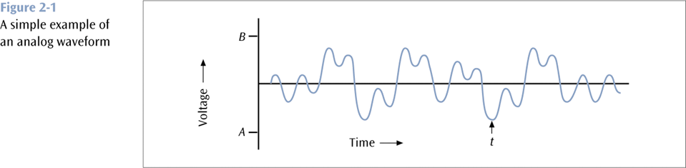
Analog vs. Digital (continued)

Slide 24
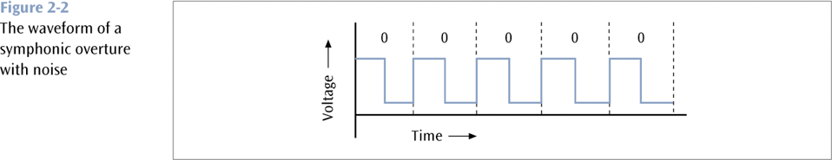
Analog vs. Digital (continued)

Slide 25
Analog vs. Digital (continued)
Digital is a discrete or non-continuous waveform with examples such as computer 1s and 0s
Noise in digital signal
You can still discern a high voltage from a low voltage
Too much noise – you cannot discern a high voltage from a low voltage

Slide 26
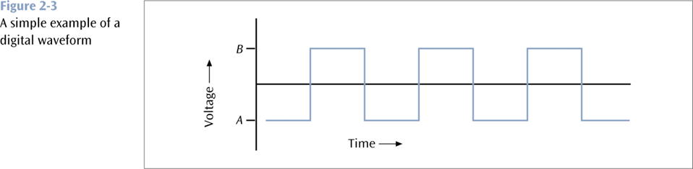
Analog vs. Digital (continued)

Slide 27
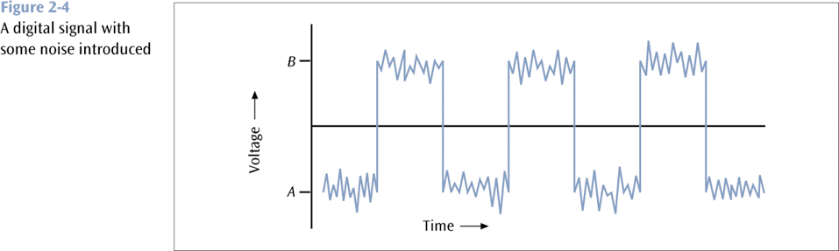
Analog vs. Digital (continued)

Slide 28
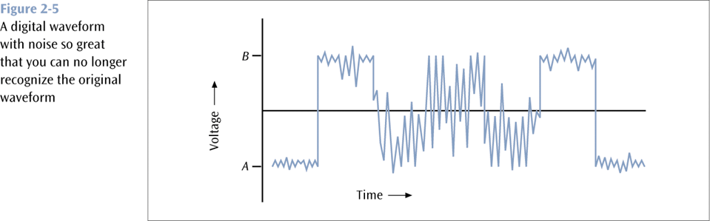
Analog vs. Digital (continued)

Slide 29
Fundamentals of Signals
All signals/ EM waves have three components:
Amplitude
Frequency
Phase
and can be expressed as a sinusoid or cosinoid of the from S=A cos(2 πft +ϕ)
And travel in composite form each unique signal is related to the fundamental frequencies
A - Amplitude
The height of the wave above or below a given reference point
S=5 cos(2 π5t + π/4) here 5V is amplitude

Slide 30
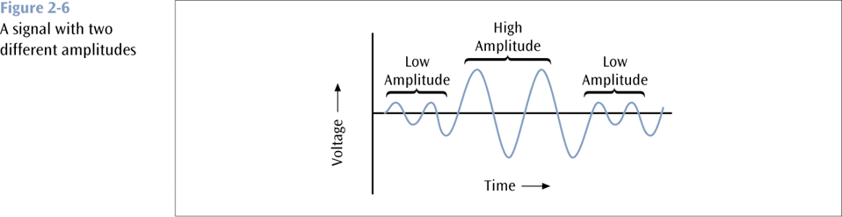
Fundamentals of Signals (continued)

Slide 31
Fundamentals of Signals (continued)
f - Frequency
The number of times a signal makes a complete cycle within a given time frame; frequency is measured in Hertz (Hz), or cycles per second e.g. S=5cos(2π5t) here f=5Hz
Spectrum – Range of frequencies that a signal spans from minimum to maximum e.g. S=S₁+S₂ where S₁=cos(2π5t) and S₂=cos(2π7t). Here spectrum SP={5Hz,7Hz}.
Bandwidth – Absolute value of the difference between the lowest and highest frequencies of a signal. In the above example bandwidth is BW=2Hz.
Consider an average voice
The average voice has a frequency range of roughly 300 Hz to 3100 Hz
The spectrum would be 300 – 3100 Hz
The bandwidth would be 2800 Hz

Slide 32
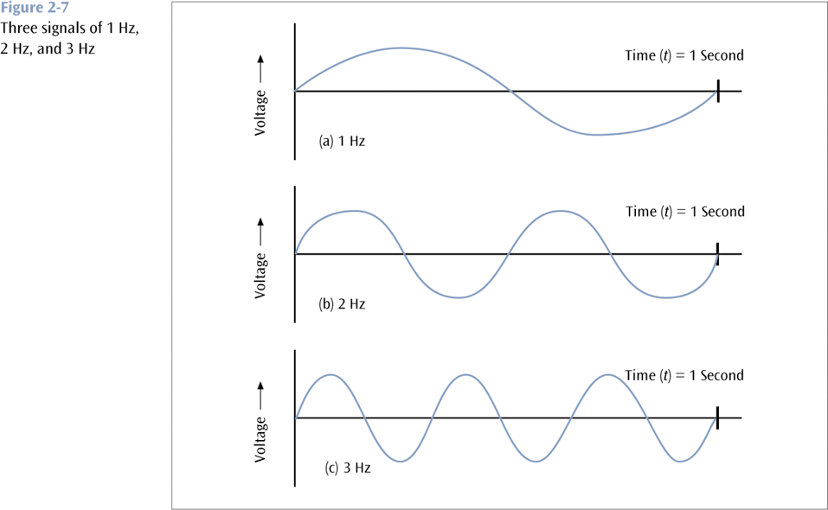
Fundamentals of Signals (continued)

Slide 33
Fundamentals of Signals (continued)
ϕ - Phase
The position of the waveform relative to a given moment of time or relative to time zero, e.g. S₁=cos(2π5t) and S₂=cos(2π5t + π/2). Here S₁ has phase ϕ=0 and S₂ has phase ϕ= π/2.
A change in phase can be any number of angles between 0 and 360 degrees
Phase changes often occur on common angles, such as π/4=45, π/2=90, 3π/4=135, etc.

Slide 34
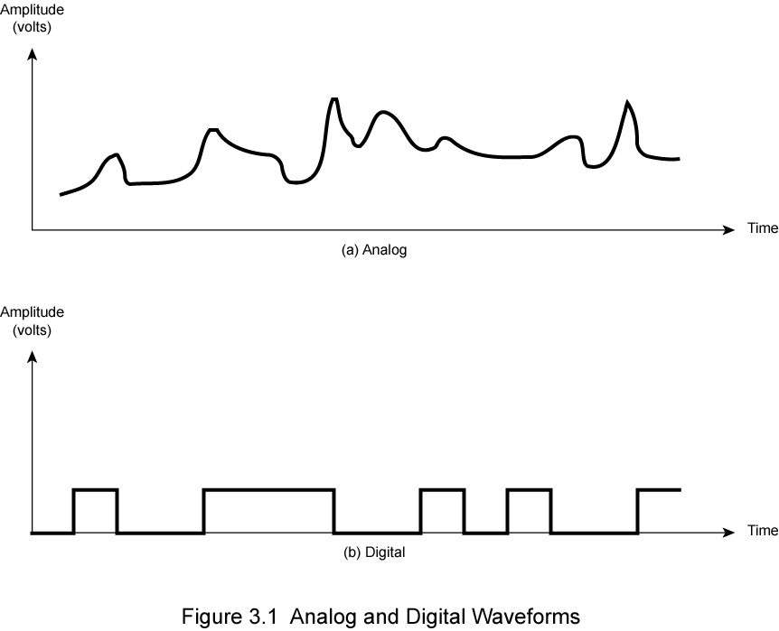
Analogue & Digital Signals
Notes:
Stallings DCC8e Figure 3.1 shows an example of both analog or digital signals. The continuous signal might represent speech, and the discrete signal might represent binary 1s and 0s.

Slide 35
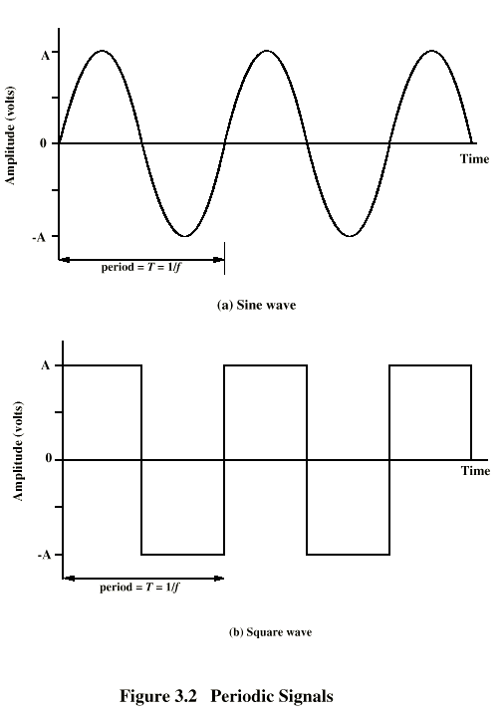
Periodic Signals
Notes:
In Stallings DCC8e Figure 3.2 a signal is generated by the transmitter and transmitted over a medium. The signal is a function of time, but it can also be expressed as a function of frequency; that is, the signal consists of components of different frequencies. It turns out that the frequency domain view of a signal is more important to an understanding of data transmission than a time domain view. Both views are introduced here.

Slide 36
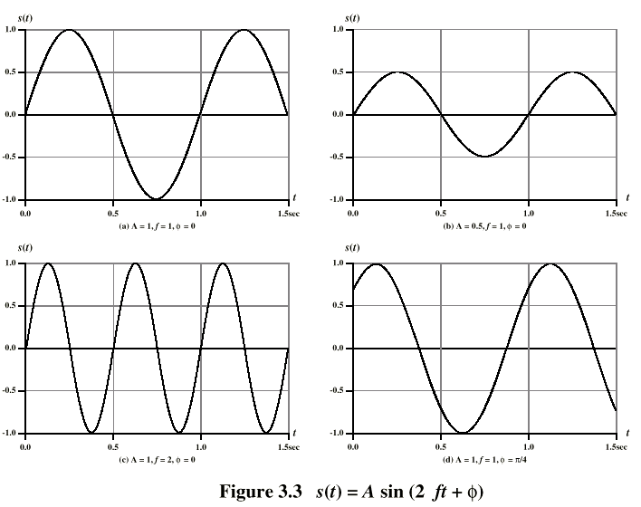
Varying Sine Waves s(t) = A sin(2πft +Φ)
Notes:
The general sine wave can be written as: s(t) = A sin(2πft + φ), known as a sinusoid function.
Stallings DCC8e Figure 3.3 shows the effect of varying each of the three parameters, the horizontal axis is time; the graphs display the value of a signal at a given point in space as a function of time. In part (a) of the figure, the frequency is 1 Hz; thus the period is T = 1 second. Part (b) has the same frequency and phase but a peak amplitude of 0.5. In part (c) we have f = 2, which is equivalent to T = 0.5. Finally, part (d) shows the effect of a phase shift of π/4 radians, which is 45 degrees (2π radians = 360˚ = 1 period).
These same graphs, with a change of scale, can apply with horizontal axes in space. In this case, the graphs display the value of a signal at a given point in time as a function of distance.

Slide 37
Wavelength (λ)
is distance occupied by one cycle
between two points of corresponding phase in two consecutive cycles
assuming signal velocity v have λ = vT
or equivalently λf = v
especially when v=c
c = 3*10⁸ ms⁻¹ (speed of light in free space)
Notes:
There is a simple relationship between the two sine waves, one in time and one in space. The wavelength (λ) of a signal is the distance occupied by a single cycle, or, put another way, the distance between two points of corresponding phase of two consecutive cycles. Assume that the signal is traveling with a velocity v. Then the wavelength is related to the period as follows: λ = vT. Equivalently, λf = v. Of particular relevance to this discussion is the case where v = c, the speed of light in free space, which is approximately 3 × 10⁸ m/s.

Slide 38
Frequency Domain Concepts
signal are made up of many frequencies
components are sine waves
Fourier analysis can shown that any signal is made up of component sine waves
can plot frequency domain functions
Notes:
In practice, an electromagnetic signal will be made up of many frequencies. It can be shown, using a discipline known as Fourier analysis, that any signal is made up of components at various frequencies, in which each component is a sinusoid. By adding together enough sinusoidal signals, each with the appropriate amplitude, frequency, and phase, any electromagnetic signal can be constructed.

Slide 39
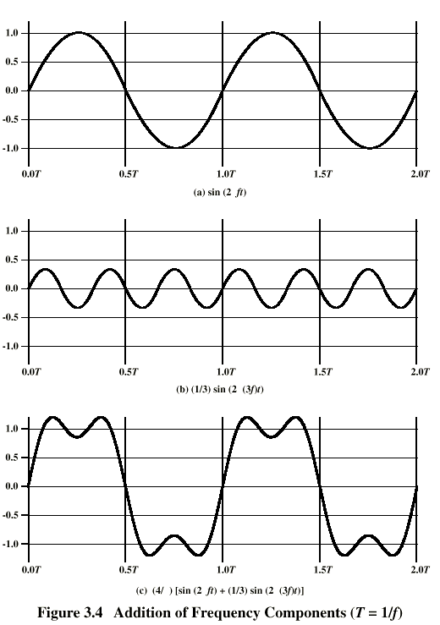
Addition of Frequency Components (T=1/f)
c is sum of f & 3f
Notes:
In Stallings DCC8e Figure 3.4c, the components of this signal are just sine waves of frequencies f and 3f, as shpwn in parts (a) and (b).

Slide 40
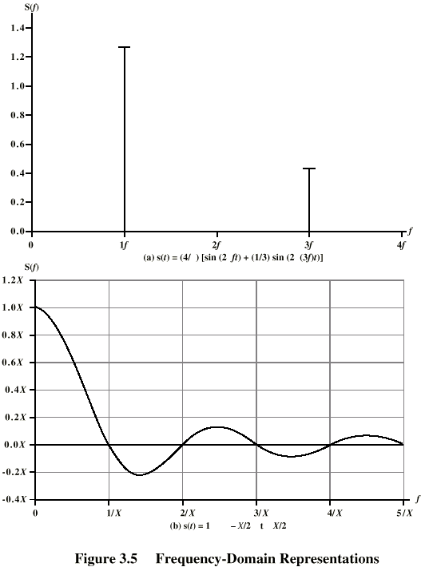
Frequency Domain Representations
freq domain func of Fig 3.4c
freq domain func of single square pulse
Notes:
So we can say that for each signal, there is a time domain function s(t) that specifies the amplitude of the signal at each instant in time. Similarly, there is a frequency domain function S(f) that specifies the peak amplitude of the constituent frequencies of the signal.
In Stallings DCC8e Figure 3.5a shows the frequency domain function for the signal of Figure 3.4c. Note that, in this case, S(f) is discrete. Figure 3.5b shows the frequency domain function for a single square pulse that has the value 1 between –X/2 and X/2, and is 0 elsewhere. Note that in this case S(f) is continuous and that it has nonzero values indefinitely, although the magnitude of the frequency components rapidly shrinks for larger f. These characteristics are common for real signals.

Slide 41
Data Rate and Bandwidth
any transmission system has a limited band of frequencies
this limits the data rate that can be carried
square have infinite components and hence bandwidth
but most energy in first few components
limited bandwidth increases distortion
have a direct relationship between data rate & bandwidth
Notes:
Although a given waveform may contain frequencies over a very broad range, as a practical matter any transmission system (transmitter plus medium plus receiver) will be able to accommodate only a limited band of frequencies. This, in turn, limits the data rate that can be carried on the transmission medium.
A square wave has an infinite number of frequency components and hence an infinite bandwidth. However, the peak amplitude of the kth frequency component, kf, is only 1/k, so most of the energy in this waveform is in the first few frequency components.
In general, any digital waveform will have infinite bandwidth. If we attempt to transmit this waveform as a signal over any medium, the transmission system will limit the bandwidth that can be transmitted. For any given medium, the greater the bandwidth transmitted, the greater the cost. The more limited the bandwidth, the greater the distortion, and the greater the potential for error by the receiver.
There is a direct relationship between data rate and bandwidth: the higher the data rate of a signal, the greater is its required effective bandwidth.

Slide 42
Analog and Digital Data Transmission
data
entities that convey meaning
signals & signalling
electric or electromagnetic representations of data, physically propagates along medium
transmission
communication of data by propagation and processing of signals
Notes:
Have seen already that analog and digital roughly correspond to continuous and discrete respectively.
Define data as entities that convey meaning, or information.
Signals are electric or electromagnetic representations of data.
Signaling is the physical propagation of the signal along a suitable medium.
Transmission is the communication of data by the propagation and processing of signals.

Slide 43
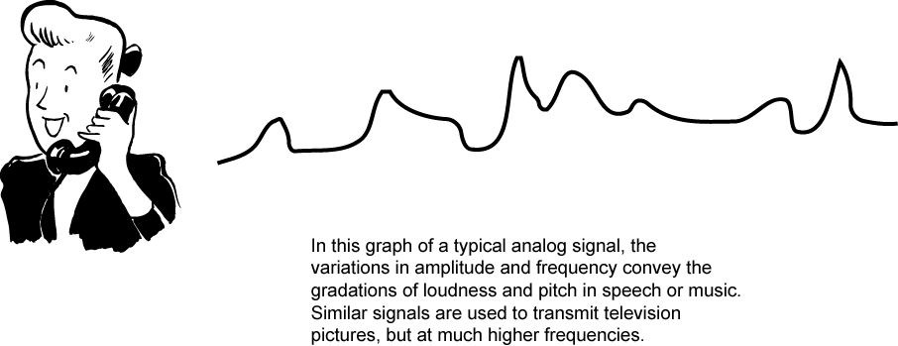
Audio Signals
freq range 20Hz-20kHz (speech 100Hz-7kHz)
easily converted into electromagnetic signals
varying volume converted to varying voltage
can limit frequency range for voice channel to 300-3400Hz
Notes:
The most familiar example of analog information is audio/acoustic sound wave information, eg. human speech. It is easily converted to an electromagnetic signal for transmission as shown in Stallings DCC8e Figure 3.12. All of the sound frequencies, whose amplitude is measured in terms of loudness, are converted into electromagnetic frequencies, whose amplitude is measured in volts. The telephone handset contains a simple mechanism for making such a conversion. In the case of acoustic data (voice), the data can be represented directly by an electromagnetic signal occupying the same spectrum. The spectrum of speech is approximately 100 Hz to 7 kHz, although a much narrower bandwidth will produce acceptable voice reproduction. The standard spectrum for a voice channel is 300 to 3400 Hz.

Slide 44
Video Signals
USA - 483 lines per frame, at frames per sec
have 525 lines but 42 lost during vertical retrace
525 lines x 30 scans = 15750 lines per sec
63.5μs per line
11μs for retrace, so 52.5 μs per video line
max frequency if line alternates black and white
horizontal resolution is about 450 lines giving 225 cycles of wave in 52.5 μs
max frequency of 4.2MHz
Notes:
Now consider video signal, produced by a TV camera. The US standard is 525 lines, with 42 lost during vertical retrace. Thus the horizontal scanning frequency is (525 lines) × (30 scan/s) = 15,750 lines per second, or 63.5 µs/line. Of the 63.5 µs, about 11 µs are allowed for horizontal retrace, leaving a total of 52.5 µs per video line. To estimate the bandwidth needed use max frequency when lines alternate black & white. The subjective resolution is about 70% of 525-42, or about 338 lines. Want horizontal and vertical resolutions about the same, and ratio of width to height of a TV screen is 4 : 3, so the horizontal resolution computes to about 4/3 × 338 = 450 lines. As a worst case, a scanning line would be made up of 450 elements alternating black and white, ie 450/2 = 225 cycles of the wave in 52.5 µs, for a maximum frequency of about 4.2 MHz.

Slide 45
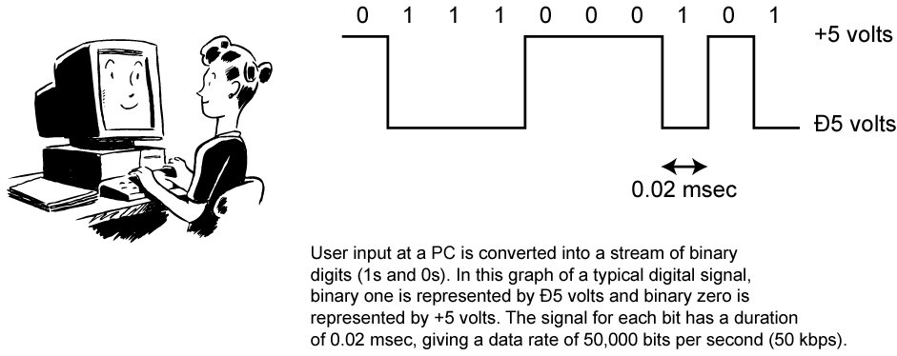
Digital Data
as generated by computers etc.
has two dc components
bandwidth depends on data rate
Notes:
Lastly consider binary data, as generated by terminals, computers, and other data processing equipment and then converted into digital voltage pulses for transmission. This is illustrated in Stallings DCC8e Figure 3.13. A commonly used signal for such data uses two constant (dc) voltage levels, one level for binary 1 and one level for binary 0. Consider the bandwidth of such a signal, which depends on the exact shape of the waveform and the sequence of 1s and 0s. The greater the bandwidth of the signal, the more faithfully it approximates a digital pulse stream.

Slide 46
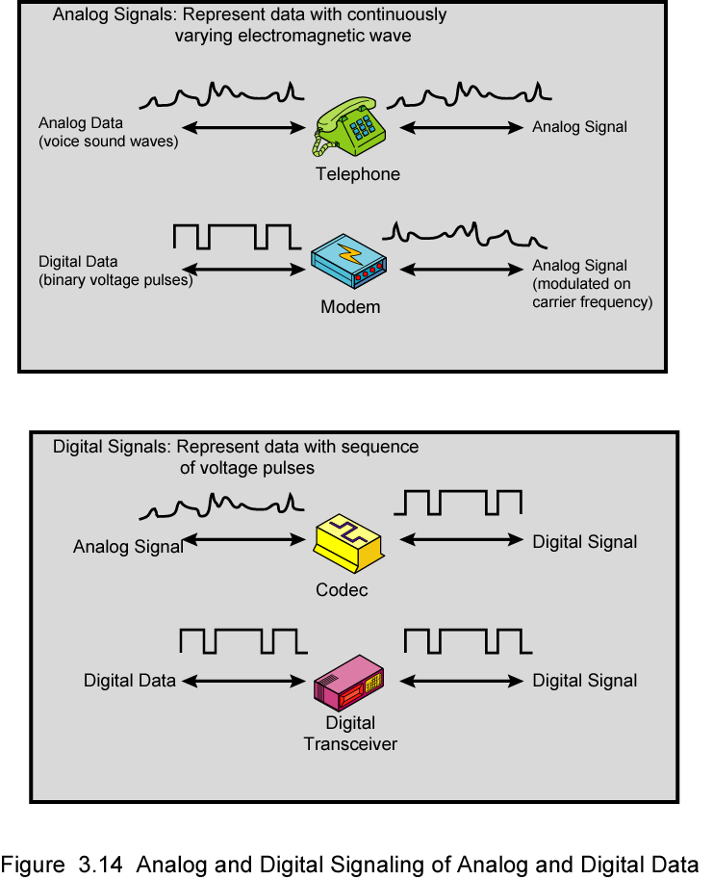
Analog Signals
Notes:
In a communications system, data are propagated from one point to another by means of electromagnetic signals. Both analog and digital signals may be transmitted on suitable transmission media.
An analog signal is a continuously varying electromagnetic wave that may be propagated over a variety of media, depending on spectrum; examples are wire media, such as twisted pair and coaxial cable; fiber optic cable; and unguided media, such as atmosphere or space propagation.
As Stallings DCC8e Figure 3.14 illustrates, analog signals can be used to transmit both analog data represented by an electromagnetic signal occupying the same spectrum, and digital data using a modem (modulator/demodulator) to modulate the digital data on some carrier frequency.
However, analog signal will become weaker (attenuate) after a certain distance. To achieve longer distances, the analog transmission system includes amplifiers that boost the energy in the signal. Unfortunately, the amplifier also boosts the noise components. With amplifiers cascaded to achieve long distances, the signal becomes more and more distorted. For analog data, such as voice, quite a bit of distortion can be tolerated and the data remain intelligible. However, for digital data, cascaded amplifiers will introduce errors.

Slide 47
Digital Signals
Notes:
A digital signal is a sequence of voltage pulses that may be transmitted over a wire medium; eg. a constant positive voltage level may represent binary 0 and a constant negative voltage level may represent binary 1.
As Stallings DCC8e Figure 3.14 also illustrates, digital signals can be used to transmit both analog signals and digital data. Analog data can converted to digital using a codec (coder-decoder), which takes an analog signal that directly represents the voice data and approximates that signal by a bit stream. At the receiving end, the bit stream is used to reconstruct the analog data. Digital data can be directly represented by digital signals.
A digital signal can be transmitted only a limited distance before attenuation, noise, and other impairments endanger the integrity of the data. To achieve greater distances, repeaters are used. A repeater receives the digital signal, recovers the pattern of 1s and 0s, and retransmits a new signal. Thus the attenuation is overcome.

Slide 48
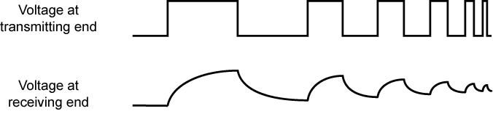
Advantages & Disadvantages of Digital Signals
cheaper
less susceptible to noise
but greater attenuation
digital now preferred choice
Notes:
The principal advantages of digital signaling are that it is generally cheaper than analog signaling and is less susceptible to noise interference. The principal disadvantage is that digital signals suffer more from attenuation than do analog signals. Stallings DCC8e Figure 3.11 shows a sequence of voltage pulses, generated by a source using two voltage levels, and the received voltage some distance down a conducting medium. Because of the attenuation, or reduction, of signal strength at higher frequencies, the pulses become rounded and smaller.
Which is the preferred method of transmission? The answer being supplied by the telecommunications industry and its customers is digital. Both long-haul telecommunications facilities and intra-building services have moved to digital transmission and, where possible, digital signaling techniques, for a range of reasons.

Slide 49
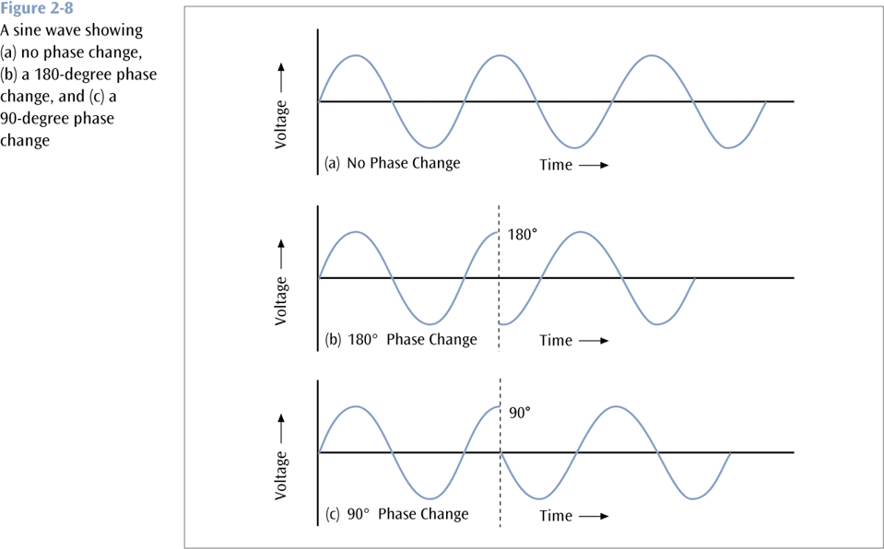
Fundamentals of Signals (continued)

Slide 50
Data Codes
The set of all textual characters or symbols and their corresponding binary patterns is called a data code
There are three common data code sets:
EBCDIC
ASCII
Unicode

Slide 51
Unicode
Each character is 16 bits
A large number of languages / character sets
For example:
T equals 0000 0000 0101 0100
r equals 0000 0000 0111 0010
a equals 0000 0000 0110 0001

Slide 52
Analogue & Digital Signals

Slide 53
Periodic Signals
Concept of periodic signal
The same signal pattern repeats over time.
Otherwise, a signal is aperiodic.
Sine Wave: represented by three parameters, s(t)=Asin(2π ft+φ)
Peak Amplitude (A)
maximum strength of signal
measured in volts
Frequency (f)
Rate of change of signal
Hertz (Hz) or cycles per second
Period = time for one repetition (T)
T = 1/f
Phase (φ)
Relative position in time within a single period of a signal
Figure (a) displays the value of a signal at a given point in space as a function of time.

Slide 54
Varying Sine Waves s(t) = A sin(2πft +Φ)

Slide 55
Analog and Digital Data Transmission
The two terms “analog” and “digital” are used frequently in the following three contexts:
Data
Entities that convey meaning or information
Signals
electromagnetic representations of data
Transmission
The communication of data by the propagation and processing of signals
Analog: continuous
Digital: discrete

Slide 56

Advantages & Disadvantages of Digital Signals
Generally cheaper than analog signaling
Less susceptible to noise
Suffer more from attenuation!
Pulses become rounded and smaller
Leads to loss of information

Slide 57
Converting Data into Signals
There are four main combinations of data and signals:
Analog data transmitted using analog signals
Digital data transmitted using digital signals
Digital data transmitted using analog signals
Analog data transmitted using digital signals

Slide 58
Transmitting Analog Data with Analog Signals
In order to transmit analog data, you can modulate the data onto a set of analog signals
Broadcast radio and television are two very common examples of this

Slide 59
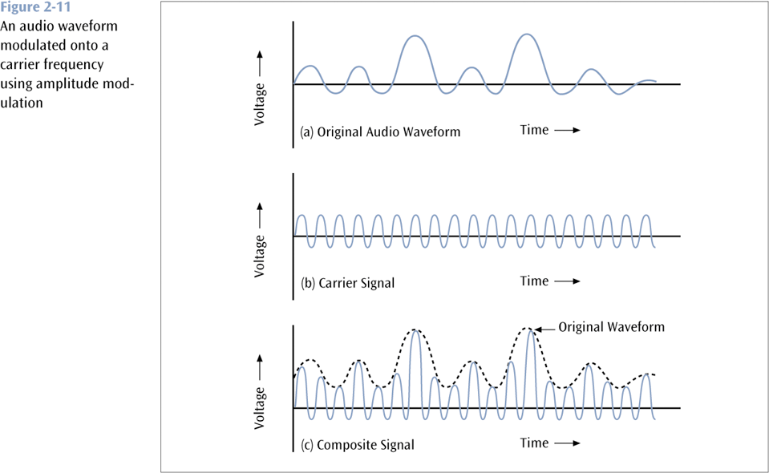
Transmitting Analog Data with Analog Signals (continued)

Slide 60
Transmitting Digital Data with Analog Signals
Three basic techniques:
Amplitude shift keying
Frequency shift keying
Phase shift keying

Slide 61
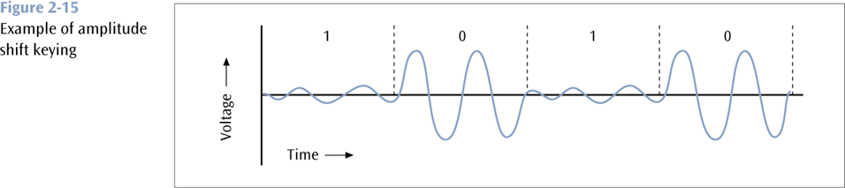
Amplitude Shift Keying (continued)

Slide 62
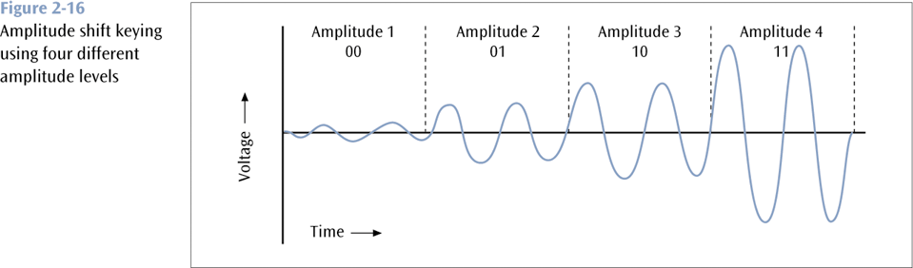
Amplitude Shift Keying (continued)

Slide 63
Frequency Shift Keying
One frequency encodes a 0 while another frequency encodes a 1 (a form of frequency modulation)

Slide 64
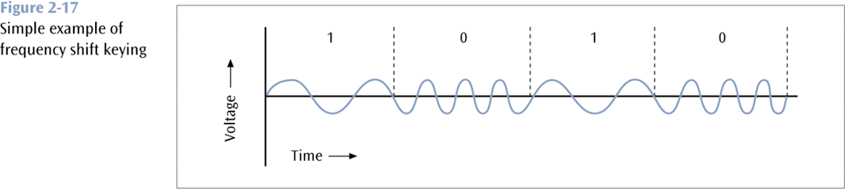
Frequency Shift Keying (continued)

Slide 65
Phase Shift Keying
One phase change encodes a 0 while another phase change encodes a 1 (a form of phase modulation)

Slide 66
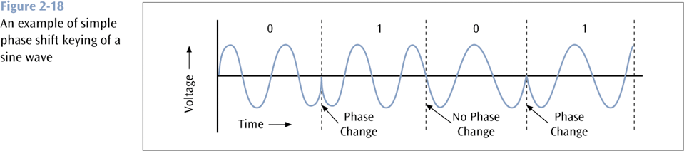
Phase Shift Keying (continued)

Slide 67
Analog Signals Carrying Analog and Digital Data

Slide 68
Digital Signals Carrying Analog and Digital Data
Analog Data

Slide 69
Transmission Impairments
With any communications system, the signal that is received may differ from the signal that is transmitted, due to various transmission impairments.
Consequences:
For analog signals: degradation of signal quality
For digital signals: bit errors
The most significant impairments include
Attenuation and attenuation distortion
Delay distortion
Noise

Slide 70
Attenuation
Attenuation: signal strength falls off with distance.
Depends on medium
For guided media, the attenuation is generally exponential and thus is typically expressed as a constant number of decibels per unit distance.
For unguided media, attenuation is a more complex function of distance and the makeup of the atmosphere.
Three considerations for the transmission engineer:
A received signal must have sufficient strength so that the electronic circuitry in the receiver can detect the signal.
The signal must maintain a level sufficiently higher than noise to be received without error.
These two problems are dealt with by the use of amplifiers or repeaters.

Slide 71
Attenuation Distortion
(Following the previous slide)
3. Attenuation is often an increasing function of frequency. This leads to attenuation distortion:
some frequency components are attenuated more than other frequency components.
Attenuation distortion is particularly noticeable for analog signals: the attenuation varies as a function of frequency, therefore the received signal is distorted, reducing intelligibility.

Slide 72
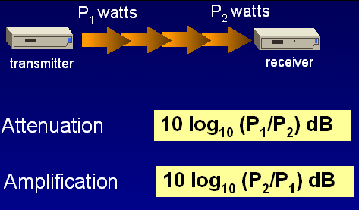
Attenuation is measured in deciBels - dB

Slide 73
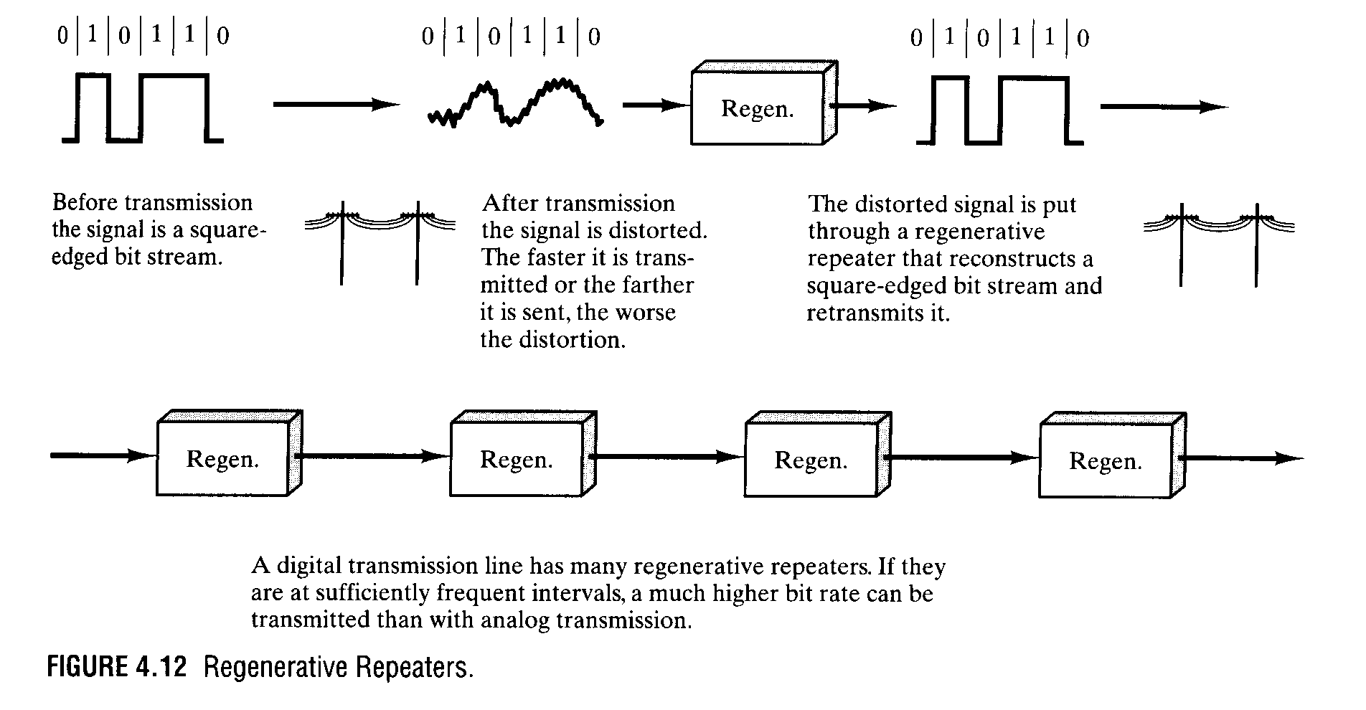
Soln? Use of Repeaters

Slide 74
Delay Distortion
Delay distortion occurs because the velocity of propagation of a signal through a guided medium varies with frequency.
Various frequency components of a signal will arrive at the receiver at different times, resulting in phase shifts between the different frequencies.
Delay distortion is particularly critical for digital data
Some of the signal components of one bit position will spill over into other bit positions, causing intersymbol interference, which is a major limitation to maximum bit rate over a transmission channel.

Slide 75
Noise
For any data transmission event, the received signal will consist of the transmitted signal, modified by the various distortions imposed by the transmission system, plus additional unwanted signals that are inserted somewhere between transmission and reception.
The undesired signals are referred to as noise, which is the major limiting factor in communications system performance.
Four categories of noise:
Thermal noise
Crosstalk
Impulse noise

Slide 76
Noise contd
Thermal noise (or white noise)
Due to thermal agitation of electrons
It is present in all electronic devices and transmission media, and is a function of temperature.
Cannot be eliminated, and therefore places an upper bound on communications system performance.

Slide 77
Noise contd
Crosstalk
It is an unwanted coupling between signal paths. It can occur by electrical coupling between nearby twisted pairs.
Typically, crosstalk is of the same order of magnitude as, or less than, thermal noise.
Impulse noise
Impulse noise is non-continuous, consisting of irregular pulses or noise spikes of short duration and of relatively high amplitude.
It is generated from a variety of cause, e.g., external electromagnetic disturbances such as lightning.
It is generally only a minor annoyance for analog data.
But it is the primary source of error in digital data communication.

Slide 78
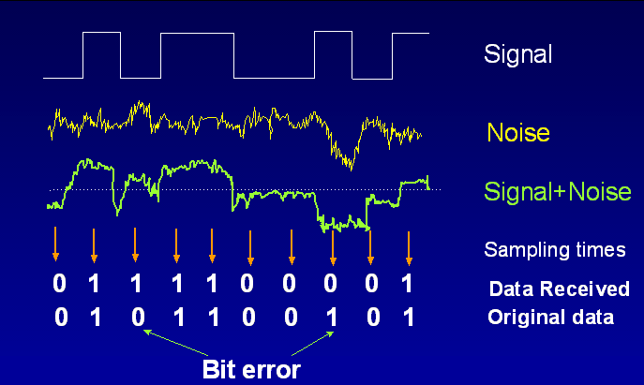
Effect of Noise

Slide 79
Transmission Impairments in Un-Guided Media
Free-Space loss
Signal disperses with distance
Atmospheric Absorption
Attenuation caused by water vapor and oxygen
Water vapor: High around 22 GHz, less around 15 GHz
Oxygen: High around 60 GHz, less below 30 GHz

Slide 80
Transmission Impairments in Un-Guided Media
Multipath
Receive multiple signals reflected by many obstacles
Refraction
Radio waves get bent by change in speed with altitude
Thermal Noise
White noise. Important factor for satellite communications

Slide 81
Channel Capacity: Recall the objectives of data Transmision
Maximize the data rate: number of bits that the system can transmit in a unit of time
within an acceptable bit error rate
Why there could be bit errors?
The signal received by the receiver is different from the signal sent from the sender
Usually, if data rate becomes higher, it is more difficult for the receiver to recognize the signal
higher data rate results in higher bit error rate
In order to achieve high data rate with low bit error rate, we need to study the principle of data communications. The ideal balance.

Slide 82
Channel Capacity
The maximum rate at which data can be transmitted over a given communication channel, under given conditions, is referred to as the channel capacity.
Data rate
The rate in bits per second (bps) at which data can be communicated
Bandwidth
In cycles per second, or Hertz
Constrained by transmitter and the nature of the medium
Error rate
The rate at which errors occur, where an error is the reception of a 1 when a 0 was transmitted or the reception of a 0 when a 1 was transmitted.
We would like to make as efficient use as possible of a given bandwidth, i.e., we would like to get as high a data rate as possible at a particular limit of error rate for a given bandwidth.

Slide 83
Two Formulas
Problem: given a bandwidth, what data rate can we achieve?
Nyquist Formula
Assume noise free
Shannon Capacity Formula
Assume white noise

Slide 84
Nyquist Formula
Assume a channel is noise free.
Nyquist formulation: if the rate of signal transmission is 2B, then a signal with frequencies no greater than B is sufficient to carry the signal rate.
Given bandwidth B, highest signal rate is 2B. Hence C=2B for binary signals
Why is there such a limitation?
due to intersymbol interference, such as is produced by delay distortion.
There are 2 peak points in one cycle... Period. So you sample at twice the frequency to get a good sample!
Given binary signal (two voltage levels), the maximum data rate supported by B Hz is 2B bps.
One signal represents one bit

Slide 85
Nyquist Formula
Signals with more than two levels can be used, i.e., each signal element can represent more than one bit. i.e more than one sample
E.g., if a signal has 4 different levels, then a signal can be used to represents two bits: 00, 01, 10, 11
With multilevel signaling, the Nyquist formula becomes:
C = 2B log₂M
M is the number of discrete signal levels that the sample is allowed to vary( M=2^{L} where L=number of bits useed to represent the sample , B is the given bandwidth, C is the channel capacity in bps.
How large can M be?
The receiver must distinguish one of M possible signal elements.
Noise and other impairments on the transmission line will limit the practical value of M.
Nyquist’s formula indicates that, if all other things are equal, doubling the bandwidth doubles the data rate.

Slide 86
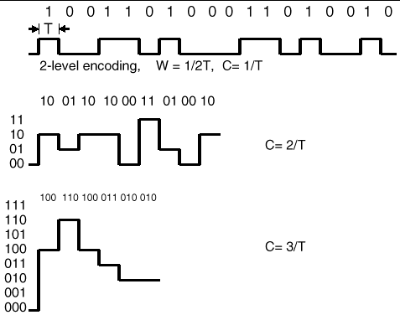

Slide 87
4-2 ANALOG-TO-DIGITAL CONVERSION
We have seen in Chapter 3 that a digital signal is superior to an analog signal. The tendency today is to change an analog signal to digital data. In this section we describe two techniques, pulse code modulation and delta modulation.
Topics discussed in this section:
Pulse Code Modulation (PCM) Delta Modulation (DM)

Slide 88
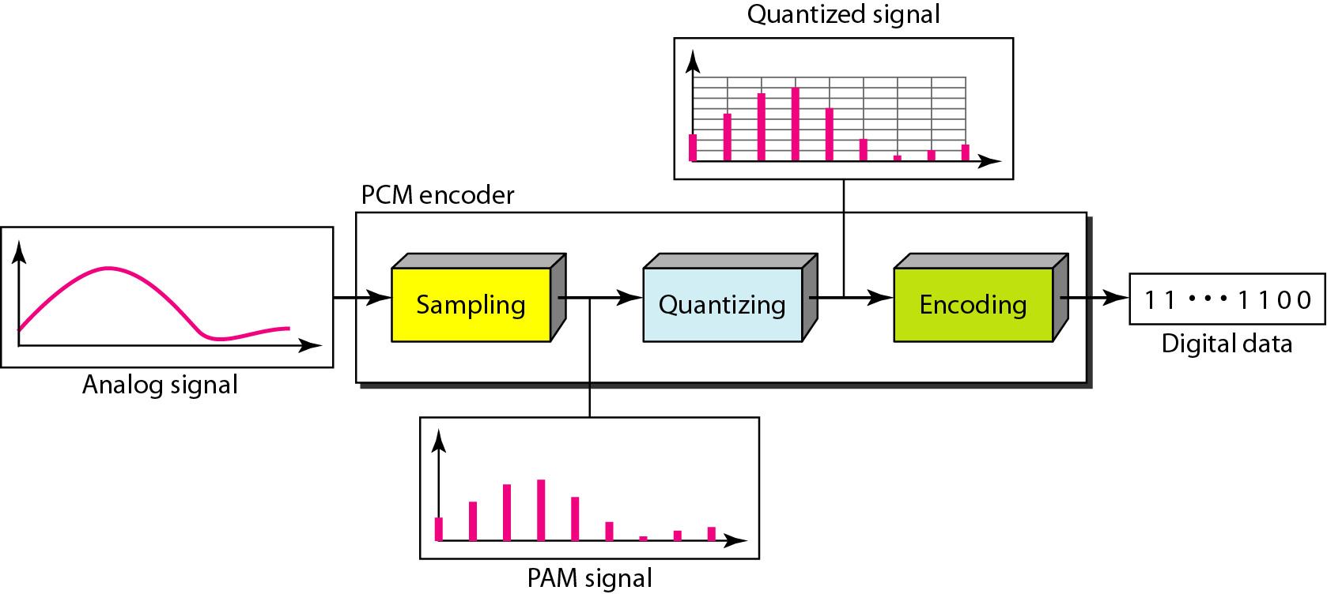
Figure 4.21 Components of PCM encoder

Slide 89
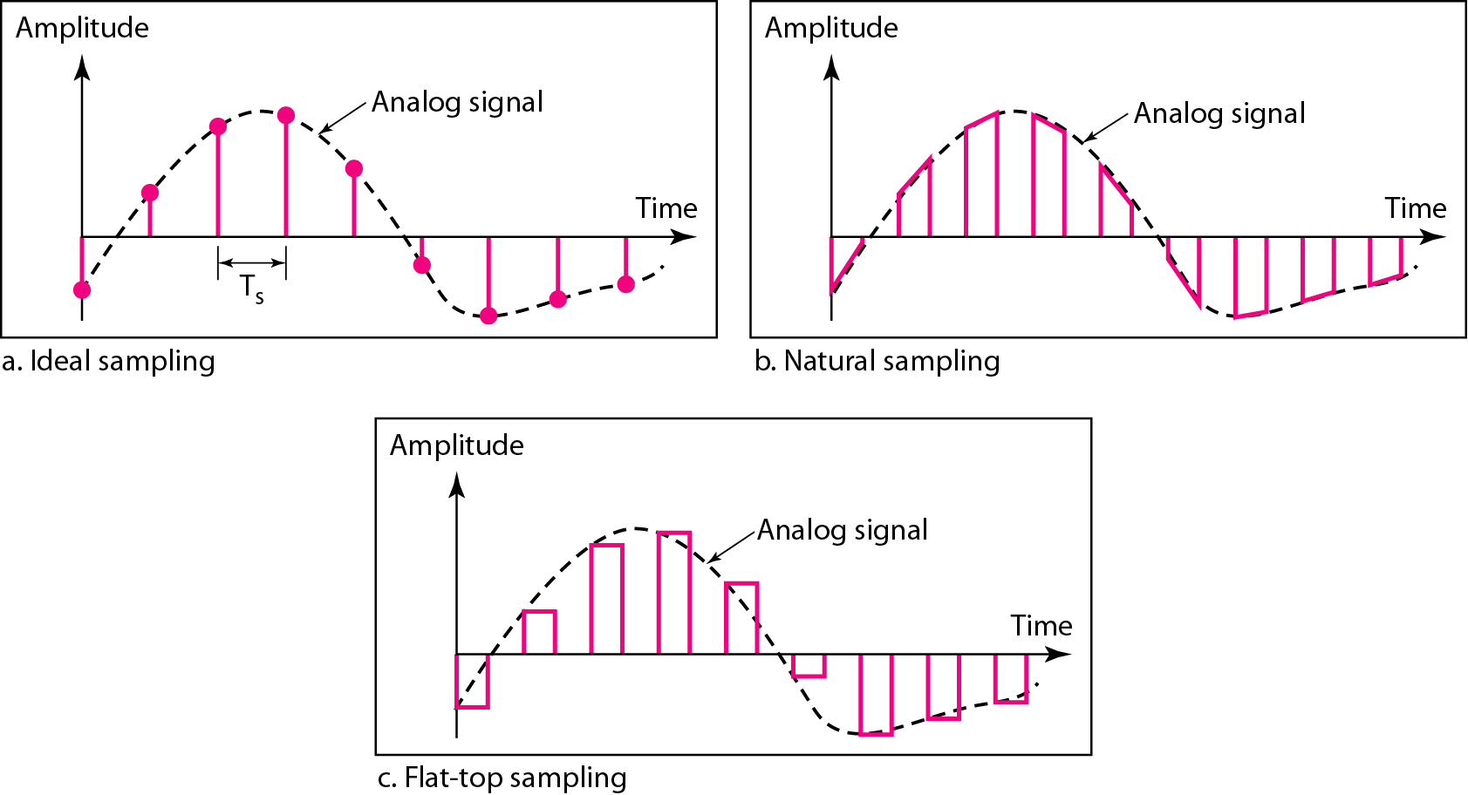
Figure 4.22 Three different sampling methods for PCM

Slide 90

Note
According to the Nyquist theorem, the sampling rate must be
at least 2 times the highest frequency contained in the signal.

Slide 91
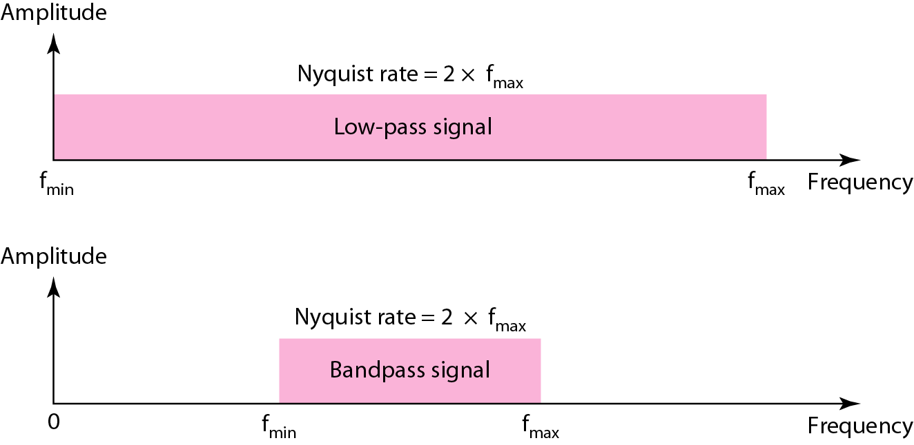
Figure 4.23 Nyquist sampling rate for low-pass and bandpass signals

Slide 92
Example 4.6
For an intuitive example of the Nyquist theorem, let us sample a simple sine wave at three sampling rates: f_{s} = 4f (2 times the Nyquist rate), f_{s} = 2f (Nyquist rate), and f_{s} = f (one-half the Nyquist rate). Figure 4.24 shows the sampling and the subsequent recovery of the signal.
It can be seen that sampling at the Nyquist rate can create a good approximation of the original sine wave (part a). Oversampling in part b can also create the same approximation, but it is redundant and unnecessary. Sampling below the Nyquist rate (part c) does not produce a signal that looks like the original sine wave….aliasing

Slide 93
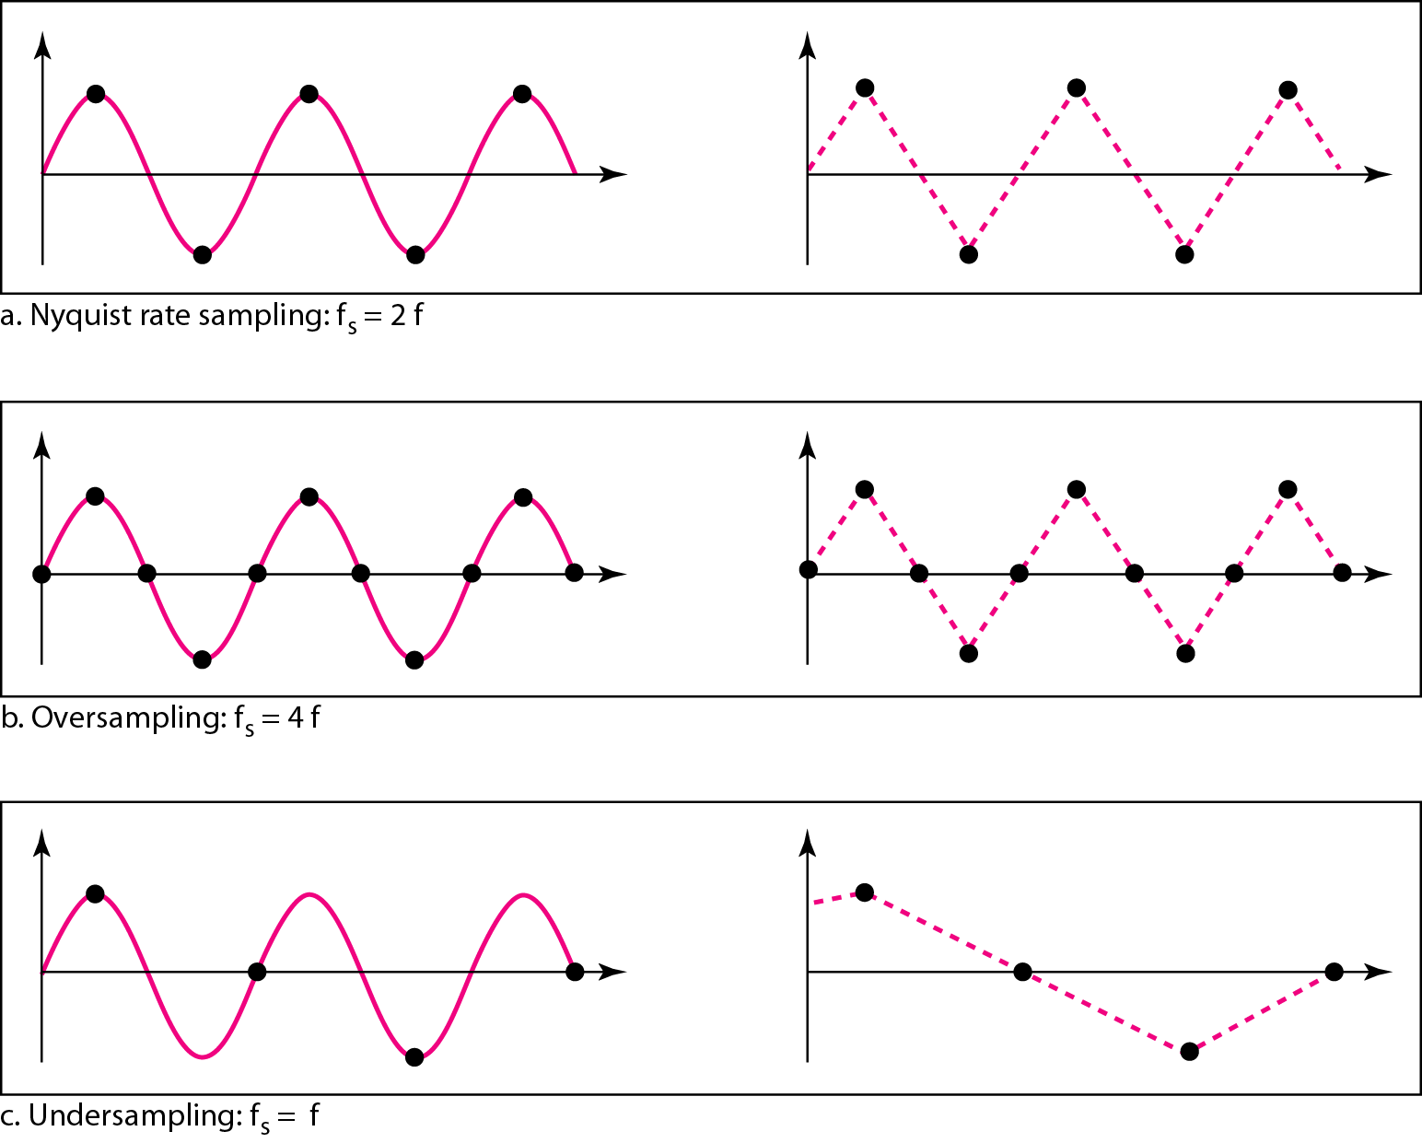
Figure 4.24 Recovery of a sampled sine wave for different sampling rates

Slide 94
Example 4.7
Consider the revolution of a hand of a clock. The second hand of a clock has a period of 60 s. According to the Nyquist theorem, we need to sample the hand every 30 s (T_{s} = T or f_{s} = 2f ). In Figure 4.25a, the sample points, in order, are 12, 6, 12, 6, 12, and 6. The receiver of the samples cannot tell if the clock is moving forward or backward. In part b, we sample at double the Nyquist rate (every 15 s). The sample points are 12, 3, 6, 9, and 12. The clock is moving forward. In part c, we sample below the Nyquist rate (T_{s} = T or f_{s} = f ). The sample points are 12, 9, 6, 3, and 12. Although the clock is moving forward, the receiver thinks that the clock is moving backward.

Slide 95
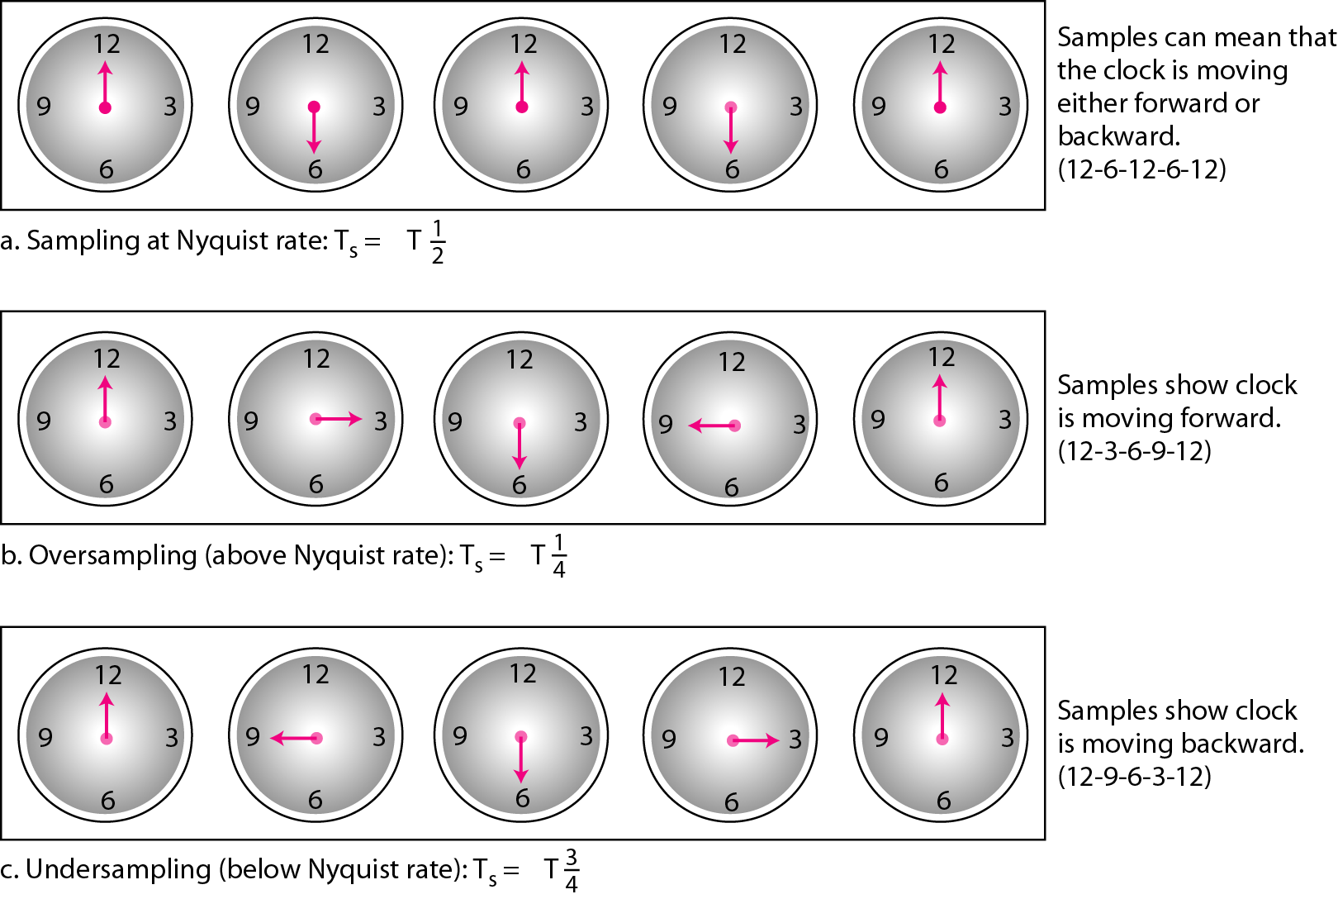
Figure 4.25 Sampling of a clock with only one hand

Slide 96
Example 4.8
An example related to Example 4.7 is the seemingly backward rotation of the wheels of a forward-moving car in a movie. This can be explained by under-sampling. A movie is filmed at 24 frames per second. If a wheel is rotating more than 12 times per second, the under-sampling creates the impression of a backward rotation.

Slide 97
Example 4.9
Telephone companies digitize voice by assuming a maximum frequency of 4000 Hz. The sampling rate therefore is 8000 samples per second.

Slide 98
Example 4.10
A complex low-pass signal has a bandwidth of 200 kHz. What is the minimum sampling rate for this signal?
Solution
The bandwidth of a low-pass signal is between 0 and f, where f is the maximum frequency in the signal. Therefore, we can sample this signal at 2 times the highest frequency (200 kHz). The sampling rate is therefore 400,000 samples per second.

Slide 99
Example 4.11
A complex bandpass signal has a bandwidth of 200 kHz. What is the minimum sampling rate for this signal?
Solution
We cannot find the minimum sampling rate in this case because we do not know where the bandwidth starts or ends. We do not know the maximum frequency in the signal.

Slide 100
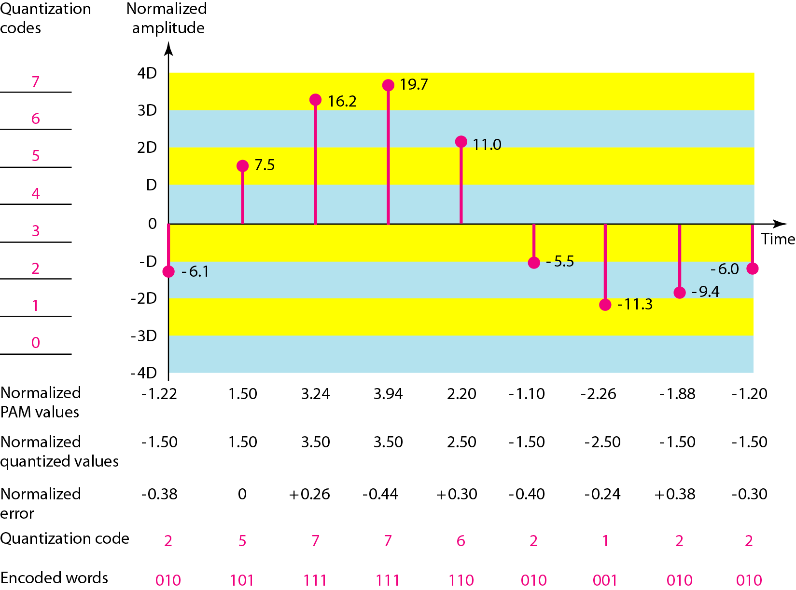
Figure 4.26 Quantization and encoding of a sampled signal

Slide 101
Quantization
Quantization Levels
Choosing lower values of L increases the quantization error if there is a lot of fluctuation in the signal.
Quantization Error
If the input value is also at the middle of the zone, there is no quantization error; otherwise, there is an error.
It can be proven that the contribution of the quantization error to the SNR_{dB} of the signal depends on the number of quantization levels L, or the bits per sample n_{b}, as shown in the following formula:
SNR_{dB} = 6.02n_{b} + 1.76 dB

Slide 102
Example 4.12
What is the SNR_{dB} in the example of Figure 4.26?
Solution
We can use the formula to find the quantization. We have eight levels and 3 bits per sample, so
SNR_{dB} = 6.02(3) + 1.76 = 19.82 dB
Increasing the number of levels increases the SNR.

Slide 103
Example 4.13
A telephone subscriber line must have an SNR_{dB} above 40. What is the minimum number of bits per sample?
Solution
We can calculate the number of bits as
Telephone companies usually assign 7 or 8 bits per sample.

Slide 104
Quantization
Uniform versus nonuniform quantization
Changes in amplitude often occur more frequently in the lower amplitudes than in the higher ones.
Nonuniform quantization
Companding
Expanding
Encoding
n_{b} = log₂L
Bit rate = sampling rate x number of bits per sample
= f_{s} x n_{b}

Slide 105
Example 4.14
We want to digitize the human voice. What is the bit rate, assuming 8 bits per sample?
Solution
The human voice normally contains frequencies from 0 to 4000 Hz. So the sampling rate and bit rate are calculated as follows:

Slide 106
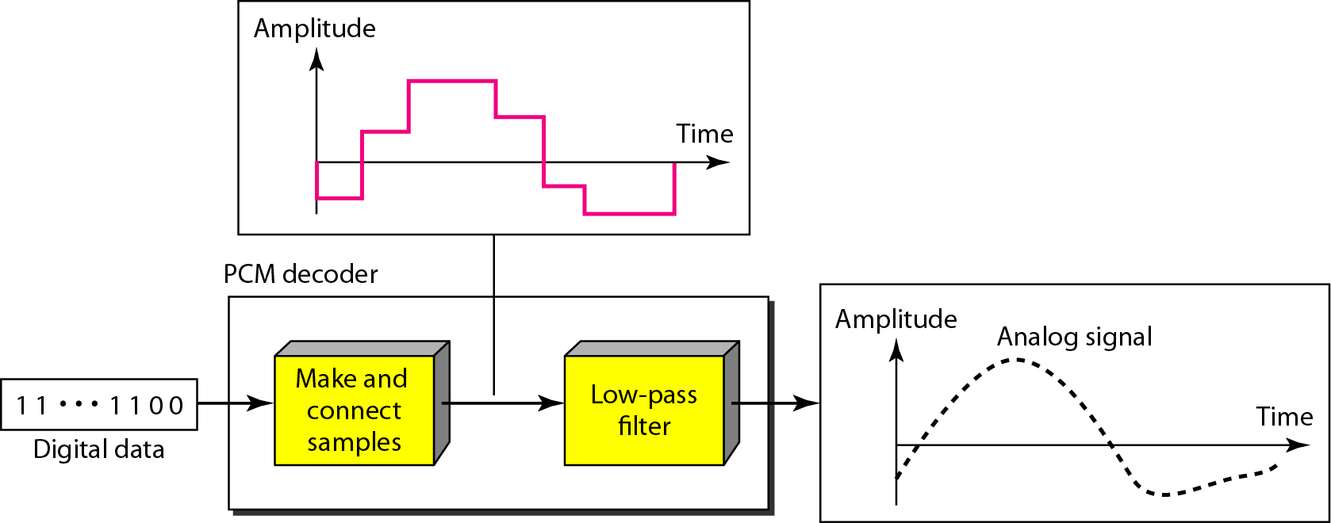
Figure 4.27 Components of a PCM decoder

Slide 107
PCM Bandwidth
The minimum bandwidth of the channel that can pass the digitized signal:
When 1/r = 1 (for NRZ or bipolar signal) and c = ½

Slide 108
Maximum data rate of a channel
Maximum data rate of a channel
The data rate is
Minimum required bandwidth
bps
Hz

Slide 109
Example 4.15
We have a low-pass analog signal of 4 kHz. If we send the analog signal, we need a channel with a minimum bandwidth of 4 kHz. If we digitize the signal and send 8 bits per sample, we need a channel with a minimum bandwidth of 8 × 4 kHz = 32 kHz.

Slide 110
Figure 4.26 Quantization and encoding of a sampled signal

Slide 111
Shannon Capacity Formula
Now consider the relationship among data rate, noise, and error rate.
Faster data rate shortens each bit, so burst of noise affects more bits
At given noise level, higher data rate results in higher error rate
All of these concepts can be tied together neatly in a formula developed by Claude Shannon.
For a given level of noise, we would expect that a greater signal strength would improve the ability to receive data correctly.
The key parameter is the SNR: Signal-to-Noise Ratio, which is the ratio of the power in a signal to the power contained in the noise.
Typically, SNR is measured at receiver, because it is the receiver that processes the signal and recovers the data.
For convenience, this ratio is often reported in decibels
SNR = signal power / noise power
SNR_{db}⁼ 10 log₁₀ (SNR)

Slide 112
Shannon Capacity Formula
Shannon Capacity Formula:
C = B log₂(1+SNR)
Only white noise is assumed. Therefore it represents the theoretical maximum that can be achieved. Note that for large values of SNR, the value of 1+SNR equates to SNR hence
C=B log₂SNR
SNR_{dB} = 10 log₁₀ SNR
This is referred to as error-free capacity.
Some remarks:
Given a level of noise, the data rate could be increased by increasing either signal strength or bandwidth.
As the signal strength increases, so do the effects of nonlinearities in the system which leads to an increase in intermodulation noise.
Because noise is assumed to be white, the wider the bandwidth, the more noise is admitted to the system. Thus, as B increases, SNR decreases.

Slide 113
Example –Binary signal
Nyquist Capacity
Consider a voice channel being used, via modem, to transmit digital data. Assume a bandwidth of B = 3100Hz. Then the Nyquist capacity, C, of the channel is:
C = 2B = 2×3100 = 6200b/s If we now assume M = 8, a value used for some modems, then C = 2B log(M) = 2B×3 = 18600b/s.

Slide 114
Example
Consider an example that relates the Nyquist and Shannon formulations. Suppose the spectrum of a channel is between 3 MHz and 4 MHz, and SNR_{dB} = 24dB. So,
B = 4 MHz – 3 MHz = 1 MHz
SNR_{dB} = 24 dB = 10 log10(SNR) → SRN = 251
Using Shannon’s formula, the capacity limit C is:
C = 10⁶ x 1og₂(1+251) ≈ 8 Mbps.
If we want to achieve this limit, how many signaling levels are required at least?
By Nyquist’s formula: C = 2Blog₂M
We have 8 x 10⁶ = 2 x 10⁶ x log₂M → M = 16.

Slide 115
Example
Suppose the spectrum of a channel is between 3MHz and 4MHz (hence bandwidth of 1MHz) and the SNR = 24dB. Then absolute SNR = 10(24/10) = 251. Using Shannons formula: C = 1MHz log2(1 + SNR) = 106 ×log2(1 + 251) ≈ 8×106 = 8Mb/s This is a theoretical limit, but if we assume we can reach it, then how? Nyquist’s theorem also tells us:
C = 2B log2(M) So 8Mb/s = 2×1MHz×log2(M). So we need M = 16. That is, our signal needs to be able to carry 16 diﬀerent levels.

Slide 116
Composite Signals and Fourier Series
To approximate a square wave with frequency f and amplitude A, the terms of the series are as follows:
Frequencies: f, 3f, 5f, 7f, …
Signals with an integer multiple of a base frequency f are called “harmonics”
Amplitudes of sine waves with these frequencies:
Note that amplitudes of higher frequencies decrease rapidly.
Frequency | Amplitude
f | 4A/π
3f | 4A/3π
5f | 4A/5π
7f | 4A/7π

Slide 117
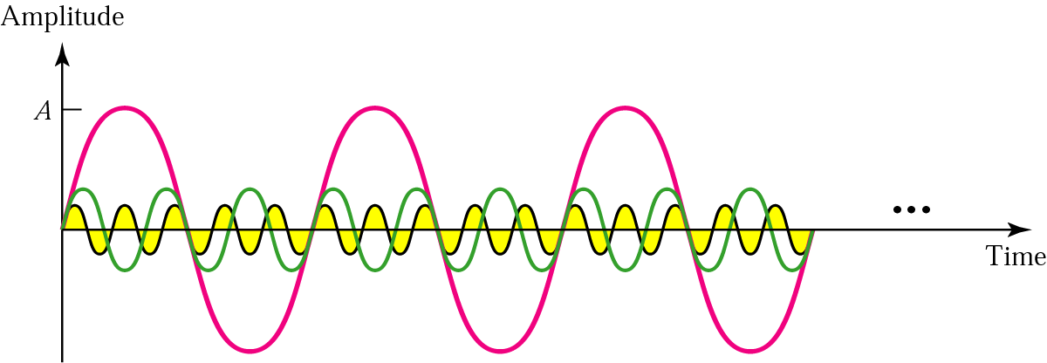
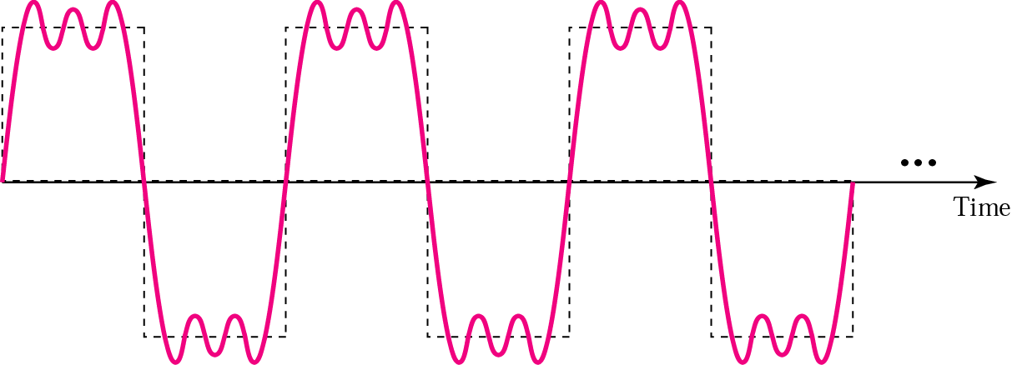
Composite analog signals

Slide 118
Signal-to-noise ratio
The ratio S / N is the “signal to noise” ratio.
Units are often reported in “bels”, which is the logarithm (base 10) of the ratio
Decibels: 10 times the above value
Example 35 dB = 3.5 bels
The ratio can also be expressed as a pure number:
S/N is 1000, meaning that the signal power is 1000 times the noise power.

Slide 119
Few things to remember
Using the calculator how to find
log₂ (x) = ln (x) / ln (2)
log₁₀ (x) = ln (x) / ln (10)
How to convert S/N to/from dB
y db = 10 log ₁₀ (S/N)
10 ^{y/10} => S/N
Also,
y = log _{n} x really means x = n ^{y}

Slide 120
Solving Questions using Nyquist Formula
C = 2B log₂ L
Given C in bits/second and L (a number). Find B in Hz?
Example : C = 1 × 10⁶ b/s and L = 8
1 × 10⁶ = 2 B log₂ (8)
B = 1.6 × 10⁷ Hz

Slide 121
Solving Questions using Nyquist Formula
C = 2B log₂ L
2. Given C in bits/second and B in Hz. Find L?
Example : C = 7 × 10⁶ b/s and B = 1.75 × 10⁶ Hz
7 × 10⁶ = 2 (1.75 × 10⁶) log₂ (L)
L = 4

Slide 122
Solving Questions using Nyquists Formula
C = 2B log₂ L
3. Given B in Hz and L (in number). Find C in b/s?
Example : B = 6 × 10⁶ Hz and L = 12
C = 2 (6 × 10⁶) log₂ (12)
C = 4.3 × 10⁷ b/s

Slide 123
Solving Questions using Shannon’s Formula
C = B log₂ S/N
1. Given C in b/s and B in Hz. Find S/N ?
Example : C = 5 × 10⁶ b/s and B = 1.25 × 10⁶
5 × 10⁶ = (1.25 × 10⁶ ) log₂ (1+ S/N)
S/N = 16
Another variation is to find S/N in decibels.
S/N = 16 = log₁₀ (16) = 1.20 bels
S/N = 1.20 * 10 = 12 decibels

Slide 124
Solving Questions using Shannon’s Formula
C = B log₂ S/N
2. Given C in b/s and S/N. Find B in Hz?
Example : C = 1 × 10⁹ Hz and S/N = 40 dB
First convert 40 dB to S/N ratio then apply Shannon’s Formula
1 × 10⁹ = B log₂ (1 + 1.0×10⁴)
B = 75.25 × 10⁶ Hz

Slide 125
Solving Questions using Shannon’s Formula
C = B log₂ S/N
3. Given B in Hz and S/N. Find C in b/s?
Example : B = 4 × 10⁹ Hz and S/N = 1023 (not in dB)
C = 4 × 10⁹ log₂ (1 + 1023)
C = 4 × 10¹⁰ b/s

Slide 126
Solving Questions using Shannon’s Formula
C = B log₂ S/N
4. Given B in Hz and S/N in dB. Find C in b/s?
Example : B = 8 × 10⁶ Hz and S/N = 45 dB
First convert decibels to S/N ratio => 10 ^{40/10}
C = 8 × 10⁶ log₂ (1 + 1.0 × 10⁴)
C = 8 × 10¹⁰ × 1.33 × 10¹
C = 1.64 × 10¹² b/s

Slide 127
Question 1
What is the maximum theoretical capacity in bits per second of a coaxial cable band with a frequency spectrum of 50 MHz to 100 MHz and a signal to noise ratio of 40 dB?

Slide 128
Question 1
What is the maximum theoretical capacity in bits per second of a coaxial cable band with a frequency spectrum of 50 MHz to 100 MHz and a signal to noise ratio of 40 dB?
Shannon’s formula:
First, determine S/N:
40 = 10 × log₁₀(S/N)
4 = log₁₀(S/N)
1.0×10⁴ = S/N
Determine B: 1.0×10⁸ – 5.0×10⁷ ⁼ 5.0 × 10⁷ b/s
C = B log₂ S/N

Slide 129
Question 2
We have a channel with a 1 MHz bandwidth. The ratio S/N is 63. What is the appropriate bit rate and number of signal levels?

Slide 130
Question 2
We have a channel with a 1 MHz bandwidth. The ratio S/N is 63. What is the appropriate bit rate and number of signal levels?
First, use Shannon’s formula to find the upper data rate at 1 signal level:
C = B log₂ S/N

Slide 131
Question 2
We have a channel with a 1 MHz bandwidth. The ratio S/N is 63. What is the appropriate bit rate and number of signal levels?
Next, use the Nyquist formula to obtain the number of signal levels L:
C = 2B log₂ L

Slide 132
Question 2
We have a channel with a 1 MHz bandwidth. The ratio S/N is 63. What is the appropriate bit rate and number of signal levels?
Next, use the Nyquist formula to obtain the number of signal levels L:
C = 2B log₂ L
6 × 10⁶ = 2 × 1 × 10⁶ log₂(L)
3 = log₂(L)
8 = L
Therefore, 8 signal levels can be used to send bits at 6 × 10⁶ b/s over this channel.

Slide 133
Question 3
Suppose that an FM radio station is allocated 200 KHz of bandwidth, and wants to digitally broadcast stereo CD music which means that 16 bits need to be sent at a sample rate of 44,100 samples per second for each of 2 sound channels. How many signal levels are needed?
C = 2B log₂ L
44100x16x2 = 2Blog₂L

Slide 134
3-5 DATA RATE LIMITS
A very important consideration in data communications is how fast we can send data, in bits per second, over a channel. Data rate depends on three factors:
1. The bandwidth available B
2. The level of the signals we use M
3. The quality of the channel (the level of noise)

Slide 135
Note
Increasing the levels of a signal increases the probability of an error occurring, in other words it reduces the reliability of the system. Why??

Slide 136
Capacity of a System
The bit rate of a system increases with an increase in the number of signal levels we use to denote a symbol.
A symbol can consist of a single bit or “n” bits.
The number of signal levels M = 2^{n}.
As the number of levels goes up, the spacing between level decreases -> increasing the probability of an error occurring in the presence of transmission impairments.

Slide 137
Nyquist Theorem
Nyquist gives the upper bound for the bit rate of a transmission system by calculating the bit rate directly from the number of bits in a symbol (or signal levels) and the bandwidth of the system (assuming 2 symbols/per cycle and first harmonic).
Nyquist theorem states that for a noiseless channel:
C = 2 B log₂2^{n}
C= capacity in bps
B = bandwidth in Hz

Slide 138
Example 3.34
Consider a noiseless channel with a bandwidth of 3000 Hz transmitting a signal with two signal levels. The maximum bit rate can be calculated as

Slide 139
Example 3.35
Consider the same noiseless channel transmitting a signal with four signal levels (for each level, we send 2 bits). The maximum bit rate can be calculated as

Slide 140
Example 3.36
We need to send 265 kbps over a noiseless channel with a bandwidth of 20 kHz. How many signal levels do we need?
Solution
We can use the Nyquist formula as shown:
Since this result is not a power of 2, we need to either increase the number of levels or reduce the bit rate. If we have 128 levels, the bit rate is 280 kbps. If we have 64 levels, the bit rate is 240 kbps.

Slide 141
Example 3.37
Consider an extremely noisy channel in which the value of the signal-to-noise ratio is almost zero. In other words, the noise is so strong that the signal is faint. For this channel the capacity C is calculated as
This means that the capacity of this channel is zero regardless of the bandwidth. In other words, we cannot receive any data through this channel.

Slide 142
Example 3.38
We can calculate the theoretical highest bit rate of a regular telephone line. A telephone line normally has a bandwidth of 3000. The signal-to-noise ratio is usually 3162. For this channel the capacity is calculated as
This means that the highest bit rate for a telephone line is 34.860 kbps. If we want to send data faster than this, we can either increase the bandwidth of the line or improve the signal-to-noise ratio.

Slide 143
Example 3.39
The signal-to-noise ratio is often given in decibels. Assume that SNR_{dB} = 36 and the channel bandwidth is 2 MHz. The theoretical channel capacity can be calculated as

Slide 144


Example 3.40
For practical purposes, when the SNR is very high, we can assume that SNR + 1 is almost the same as SNR. In these cases, the theoretical channel capacity can be simplified to
For example, we can calculate the theoretical capacity of the previous example as

Slide 145
Example 3.41
We have a channel with a 1-MHz bandwidth. The SNR for this channel is 63. What are the appropriate bit rate and signal level?
Solution
First, we use the Shannon formula to find the upper limit.

Slide 146
Example 3.41 (continued)
The Shannon formula gives us 6 Mbps, the upper limit. For better performance we choose something lower, 4 Mbps, for example. Then we use the Nyquist formula to find the number of signal levels.

Slide 147
Note
The Shannon capacity gives us the upper limit; the Nyquist formula tells us how many signal levels we need.

Slide 148
Type of Questions
Given B and S/N ratio
- find C
- find L based on C
Given B, L
- find C
- find required S/N
- find S/N in dB

Slide 149
KEY POINTS
All of the forms of information can be represented by electromagnetic signals. Depending on the transmission medium and the communications environment, either analog or digital signals can be used to convey information.
Any electromagnetic signals, analog or digital, is made up of a number of constituent frequencies. A key parameter that characterizes the signal is bandwidth, which is the width of the range of frequencies that comprises the signal. In general , the greater the bandwidth of the signal, the greater its information-carrying capacity.

Slide 150
KEY POINTS
A major problem in designing a communications facility is transmission impairment, including attenuation, distortion, and various types of noise. For analog signals, transmission impairments introduce random effects that degrade the quality of the received information and may affect intelligibility. For digital signals, transmission impairments may cause bit errors at the receiver.
Ctechgroupa2012@gmail.com,

Slide 151
KEY POINTS
The designer of a communications facility must deal with four factors: the bandwidth of the signal, the data rate that is used for digital information, the amount of noise and other impairments, and the level of error rate that is acceptable. The bandwidth is limited by the transmission medium and the desire to avoid interference with other nearby signals. Because bandwidth is a scarce resource, we would like to maximize the data rate that is achieved in a given bandwidth. The data rate is limited by the bandwidth, the presence of impairments, and the error rate that is acceptable.

